Slide 1
Recitation 2
9/17/21
Greg, Will, & Sheil

Slide 2
C Programming Refresher

Slide 3
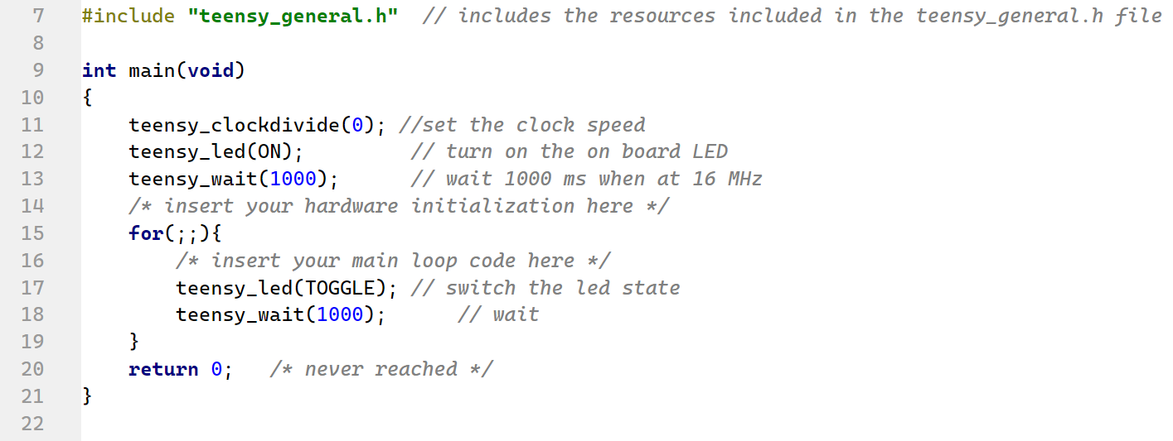
Main components of a C program
function/subroutine
Comment, has no effect on the program
Start of the program.
Each program can only have a single main function defined
Equivalent to while(1)
Return value of the function. 0 means the program exited without error.

Slide 4
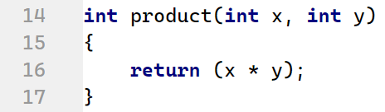
Custom C Functions: What are they, and how to use them
What is a function?
Block of code that can be reused
Helps modularize & organize code
Helps with debugging as well because once you test a function, you can use it elsewhere knowing that it will always work correctly
Note: C does not support overloading functions; i.e. you can only have one function signature and definition per function
How to create and use a function?
Declare the function
Write body
Perform some task on input arguments (copies)
Return a value
Ready for use : Call function with params
Notes:
Speaker: Sheil
The purpose of a function is to organize your program into modular building blocks which can be reused throughout the program execution.
A good rule of thumb is: any time you find yourself copy-pasting. Could a function be handling this?
Universally, a custom function you write will have 2 parts: the function declaration, the body (w/ return statement)
Once you create your function, it’s ready to be used somewhere else in your program-- and you can call it with the specified params
Pass by value by default

Slide 5
Refresher of arrays in C
Fixed length homogenous containers for variables, contiguously located in memory
type name[size]
E.g.
int sequence[5] = {1,1,2,3,5};
Constructor: int sequence[5] = {1,1,2,3,5};
Access: int x = sequence[2];
Assignment: sequence[index] = x;
index | 0 | 1 | 2 | 3 | 4
value | 1 | 1 | 2 | 3 | 5
Notes:
Note - no “strings”
Zero Indexed (NOT like MATLAB)
Careful accessing values outside of your array (may not throw an error) : undefined behaviour

Slide 6
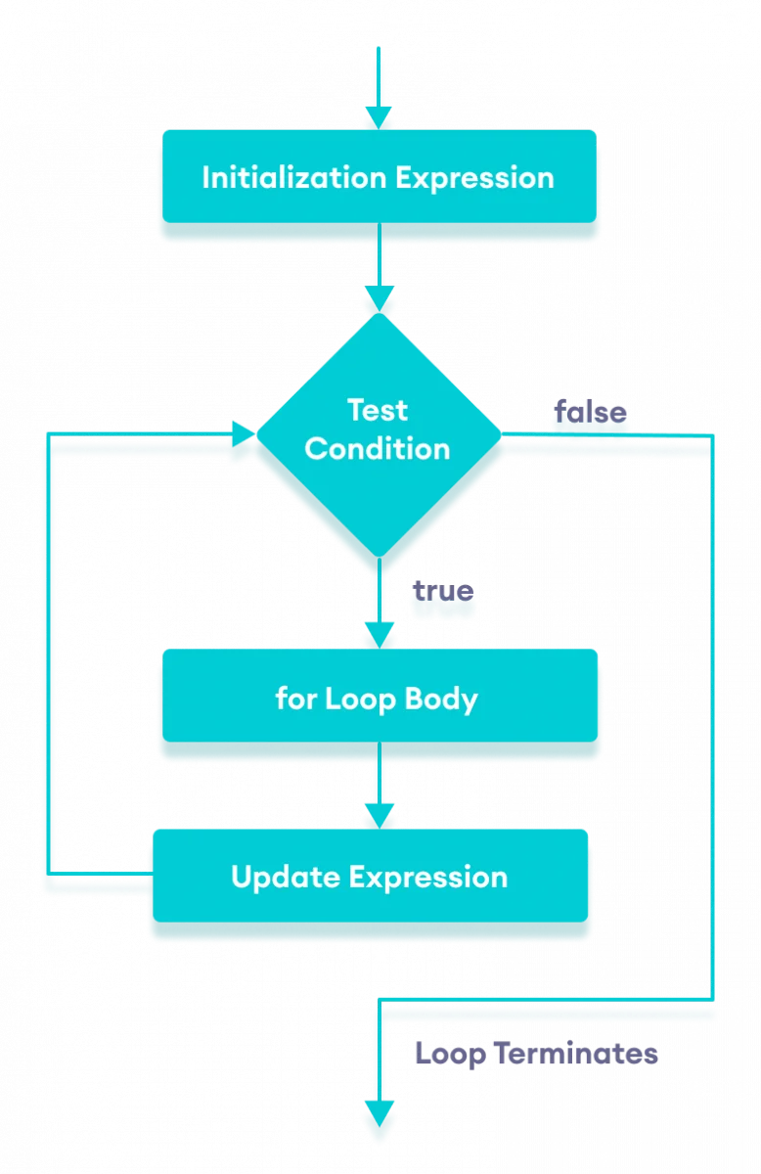
Loops in C: repeating blocks of code if a condition holds
Use-cases for loops
Maintain control in the main function (while(1) or for loop with no termination condition)
Iterating through an array (e.g. to computeAverage)
Busy-wait for hardware event
for | Execute loop body a specified number of times
while | Execute loop body if specified condition is true (repeatedly)
do while | Execute loop body then check if specified condition is true
Notes:
Now we’ll touch on loops, which is it’s own section in the upcoming assignment.
Let’s start with what are loops: loops are a way to repeat code like arithmetic operations, function calls, etc. without copying and pasting the same line over and over
C supports 3 main types of loops, and you can nest them to support your use case
On a high level, what you need to know about each type of loop is:
In the next few slides, we’ll see examples of all of them

Slide 7
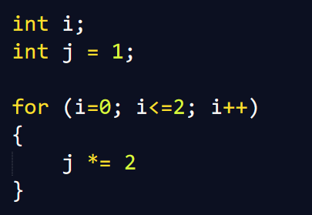
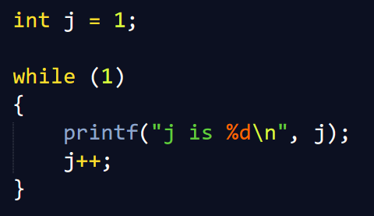
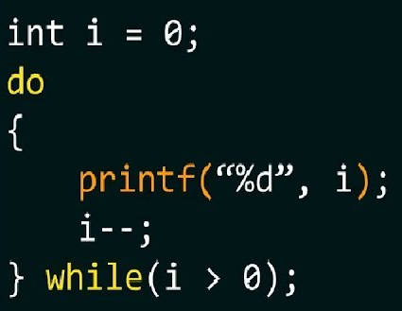
For Loop
While loop
Do While loop
Initial condition
Exit condition
Step size (increment/decrement)
Body
Condition
Body
Condition
Body
Notes:
Value of j after the loop: 2^3= 8 (zero-indexed)

Slide 8
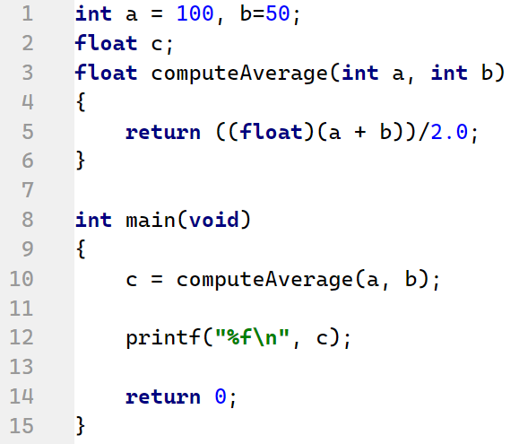
A use case for type casting in C: accurate integer division
Intended behavior:
computeAverage(10, 11)
⇒ (21.0 / 2.0)
⇒ 10.5 ✅
Without casting the numerator to a float, the result of the division would be truncated to an int:
computeAverage(10, 11)
⇒ (21 / 2)
⇒ 10 ❌
Reference: C99 Standards

Slide 9
What is type conversion and how does the C compiler do it?
Type conversion occurs when the expression has data of mixed data types.
The C compiler will promote variables from lower to higher type at runtime (because converting higher to lower involves loss of precision and value)
General Rules:
Integer types are lower than floating point types
double > float > long > int > short > char
Signed types are lower than unsigned types
Signed Signed int holds negative, zero and positive numbers
Unsigned Unsigned int can hold zero and positive numbers
Reference: C99 Standards

Slide 10
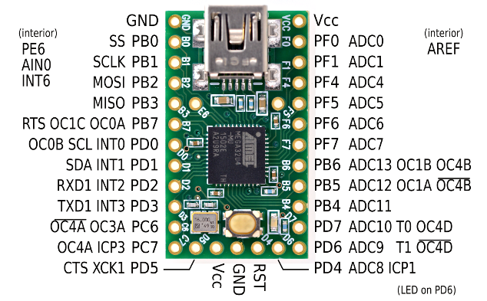
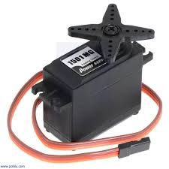
Introduction to Teensy GPIO Pins
GPIO - General Purpose Input/Output
Avoid frying your board: do not connect high current draw devices
SG90 Servo Current (typical during movement) | 100-250mA
Great reference for Teensy pinout on MEDesign

Slide 11
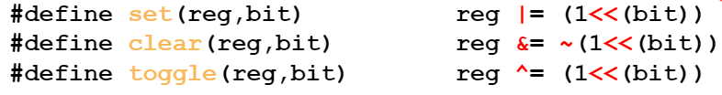
How to configure your Teensy GPIO pins for input / output
Control Registers you will use:
Direction Register (DDRx)
Determines whether the pins operate as inputs or outputs
Read/Write
Data Write Register (PORTx)
Maps to state of port (e.g. logic high/ low)
Read/Write
Data Reading Register (PINx)
Macros you will use (defined in teensy_general.h):
How to setup and use I/O Ports:
First, set to input or output with DDRx register
"Data Direction Register" - clearing a bit will configure that pin to input, while setting a bit will configure the pin for output
By default, all pins are set to input (cleared) but don’t trust this - reset the DDR before use
In output mode, control pins with PORTx register
Setting a bit drives that pin high
Clearing a bit drives that pin low
In input mode, read pins with PINx register

Slide 12
Best practices when debugging C code without print statements
Issues preventing compilation
Do all of your lines have semicolons?
Typos in function name vs what you are trying to call in main
Other syntactic errors
Code compiles, but not doing what you expect
Isolate errors by simplifying logic: comment out code
If you have branches in your program, add an LED blink to indicate when program has reached a certain control block
Are your arithmetic operations evaluating correctly: is type casting required?

Slide 13
Timers

Slide 14
Time
SI unit of time: second
What’s the smallest unit of time you can think of?
ANALOG
The ATmega (Teensy) uses a system clock that measures time in digital ‘tick’s
Each ‘tick’ is 1/(16MHz) = 62.5 ns
Notes:
pico - femto - atto - zepto - yocto - can go down indefinitely because time is ANALOG

Slide 15
Timers
Timer = type of clock (built-in hardware clock)
Basic functionality: counts up until it hits a maximum value and then reset back to 0
Runs independently of the CPU (in the “background”)
Even over blocking code ( while(1) )!
Counts at the Timer clock speed (based on system clock speed)
Timers can be difficult - constantly check your timer’s configuration details!
http://medesign.seas.upenn.edu/index.php/Guides/MaEvArM-timers

Slide 16
Timers
Components
Timer clock speed (determined by the prescaler)
Timer Mode (how the timer will count)
Counter (the value of the Timer)
Output compare
Input capture
Uses:
To count the time elapsed
To run a function at a specific frequency (advantages over wait statements)

Slide 17
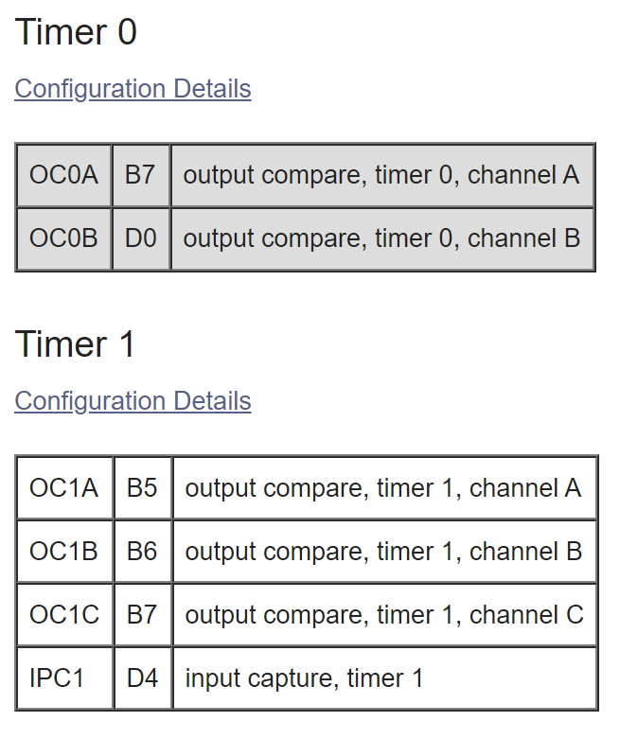
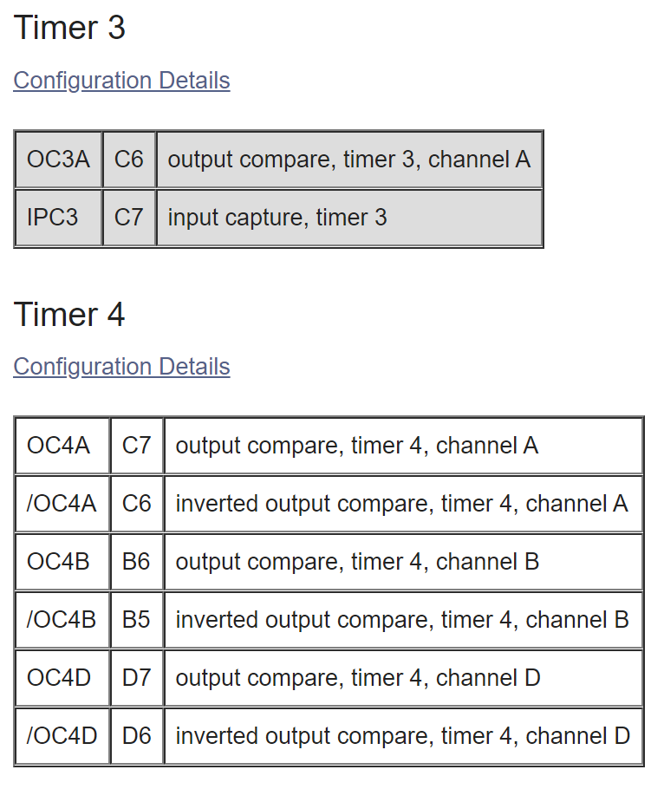
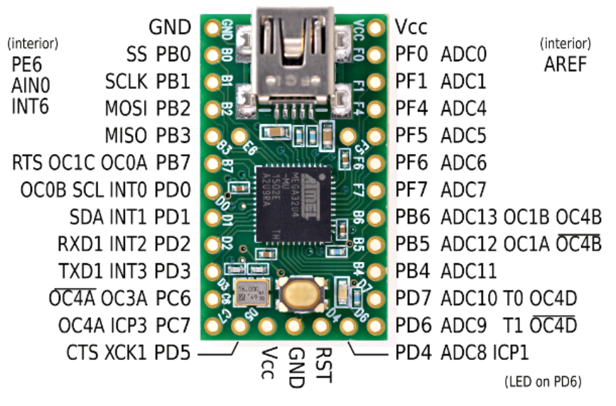
Timers (on the Teensy)
(16 bit)
(8 bit)
(10 bit)
(16 bit)

Slide 18
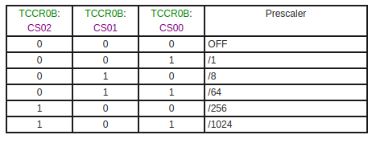
Programming Timers: Prescaler
Timer speed = clock speed ÷ prescaler
Note: prescaling the timer clock DOES NOT affect the system clock
Note: need teensy_clockdivide(0); in your code for the Teensy system clock to be 16MHz
If CS02-00 = 1 0 0 - What is the frequency of the timer 0? How do I set that?
Notes:
Frequency = 15625
set(TCCR0B, CS02); set(TCCR0B,CS00);

Slide 19
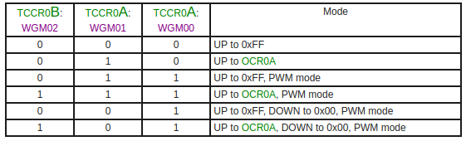
Programming Timers: Timer Modes
(mode x)
What are the steps to make timer 0 count up to 1 second repeatedly?
Notes:
Answer: you can’t.
For timers 1 or 3, you could set prescaler to 1024 and set OCR1/3A to 15,625
Minimum pre-scalar to reach 1s is 256 (OCR1/3A = 62,500)

Slide 20
Timers
Considerations when choosing a Timer (0-3)
Size of timer (# of bits, max. counter value)
Output pins (output compare)
Timer clock speed
Input capture (for later)
http://medesign.seas.upenn.edu/index.php/Guides/MaEvArM-timers

Slide 21
Pulse Width Modulation

Slide 22
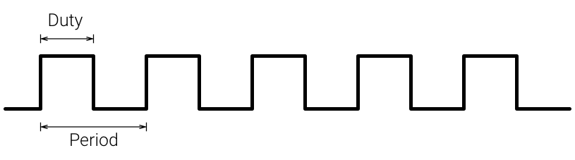
Pulse Width Modulation (PWM)
PWM = a type of digital signal
Uses:
When we only have digital power, but we want analog
Digital means that the signal can only be high or low (nothing in between)
Use cases: LED brightness, servo motors, DC motors
The digital signal can only be high (usually 5V) or low (0V or GND), but we can change the percentage of time for when the signal is high compared to when it is low.

Slide 23
Pulse Width Modulation (PWM)
Components
Duty Cycle
Frequency (Period)
Duty Cycle
Usually expressed in a %
Duty cycle% = on time ÷ period
On time = time that the signal is “high”
Frequency (1 ÷ period)
Number of cycles per second

Slide 24
Pulse Width Modulation (PWM)
Choosing a frequency
Frequency is specific to the application
Examples:
20% duty cycle @ 1 Hz for LED would just blink the LED
20% duty cycle @ 200 Hz for LED would blink the LED too quickly for our eyes to see (dimmed LED)
Higher frequency = more difficult to detect the actual blinking

Slide 25
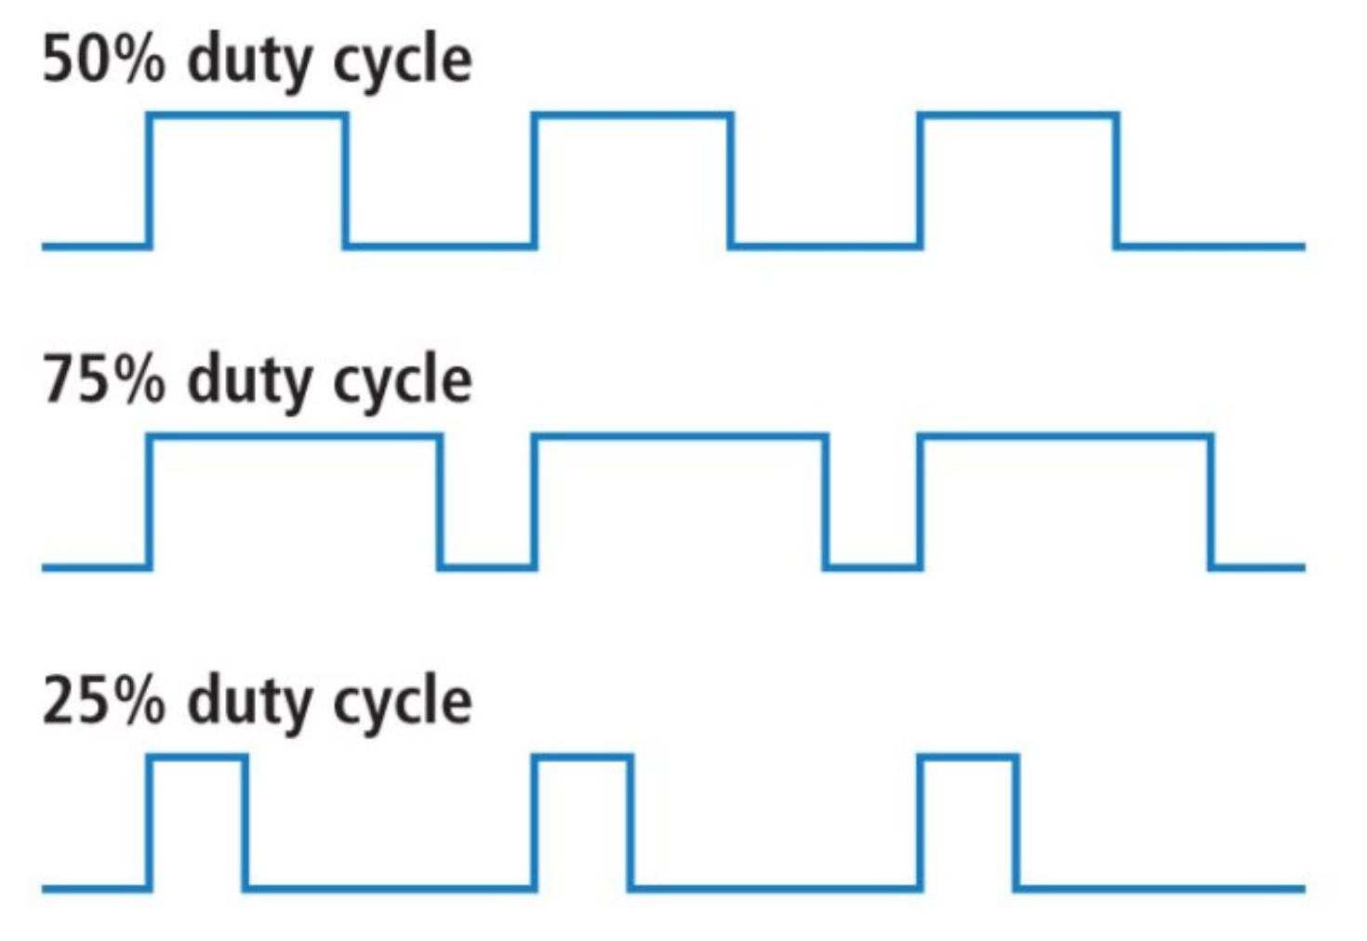
PWM without Timers
Use teensy_wait(ms);
Turn pin high, wait, turn pin low, wait, etc. (loop)
Why might we not want to do this?

Slide 26
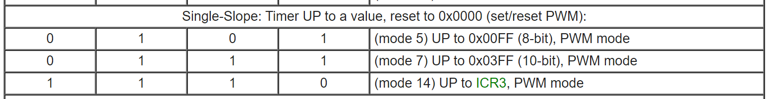
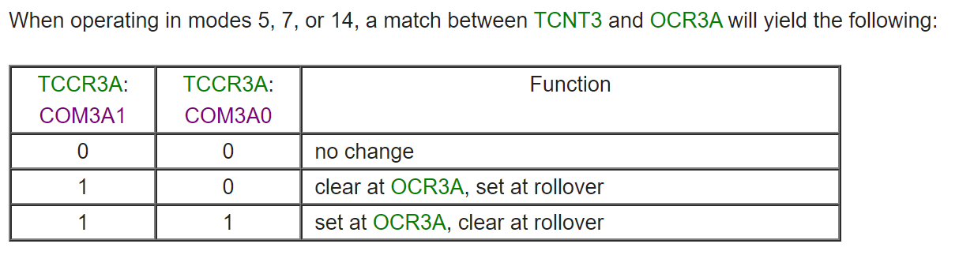
PWM with Timers
THIS SET AND CLEAR REFERS TO PORT C6
Draw the graphs of Timer counter + output

Slide 27
PWM with Timers
How can we adjust the duty cycle? → changing OCR3A

Slide 28
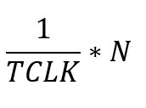
PWM with Timers
How long does it take for each cycle of the PWM to run?
Depends on the Timer clock and the value that the Timer is counting up to
Let TCLK be the Timer clock frequency in Hz, and N be the value that the Timer counts up to before resetting
Answer: Time taken for 1 period of PWM: [Units: s]
What is the period of the last example? 16MHz counting up to 0x00FF

Slide 29
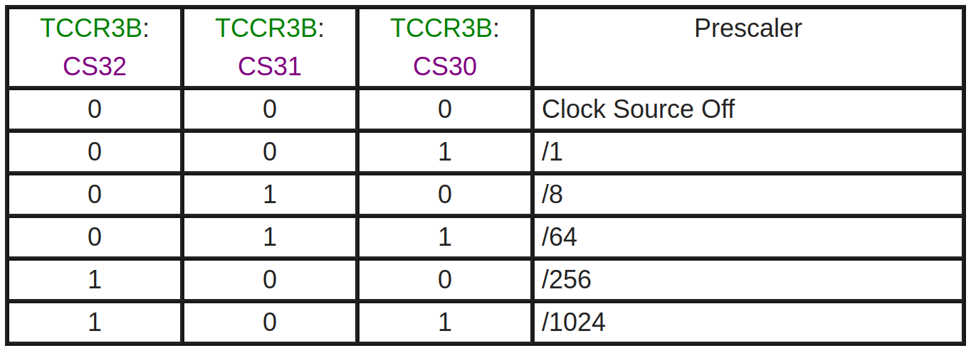
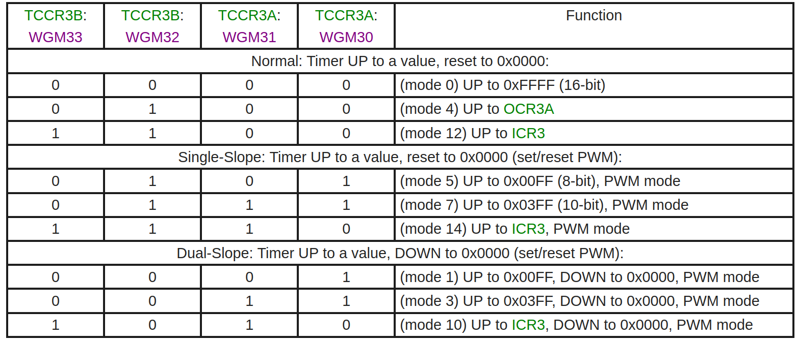
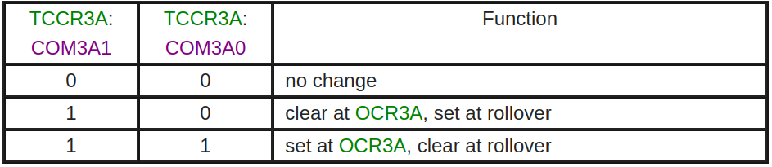
Putting it all together
Steps to set up PWM on the teensy
Initialize the timer and pre-scalar
Set the timer mode
Set the output option
Set OCR3A to adjust the duty cycle
These only need to be set once per type of PWM signal (PWM settings)

Slide 30
More Examples

Slide 31
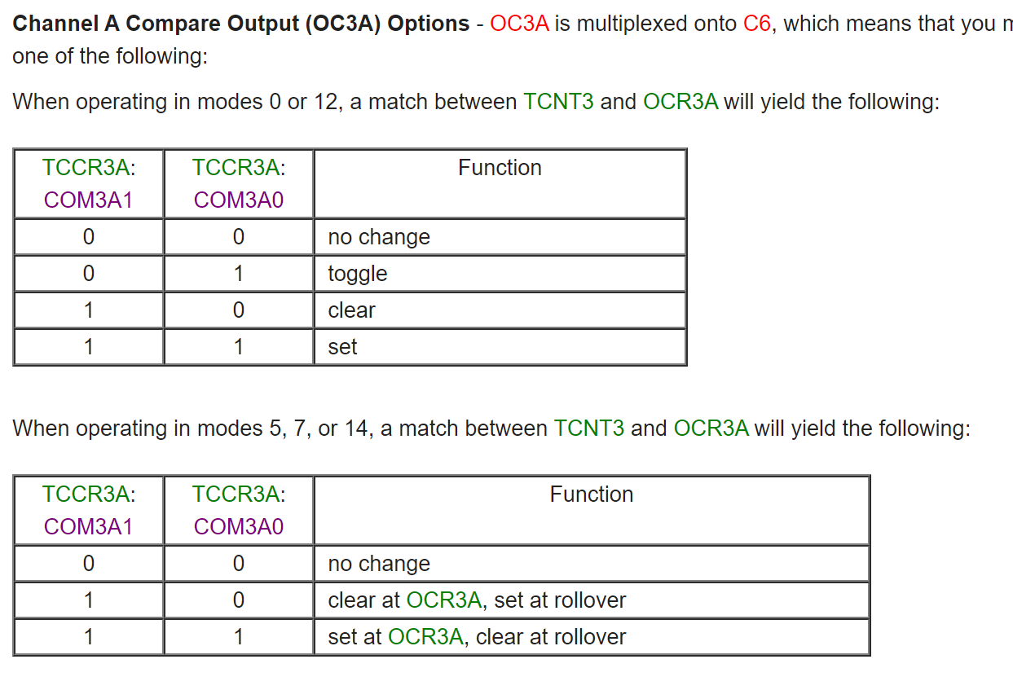
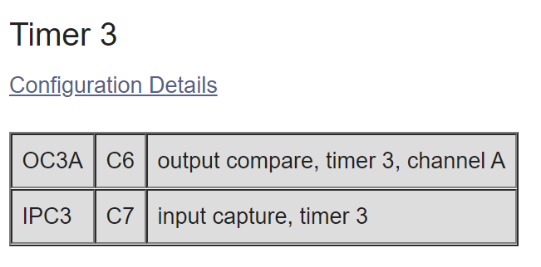
Timers
Output Compare
The pin or pins that get controlled by the Timer

Slide 32
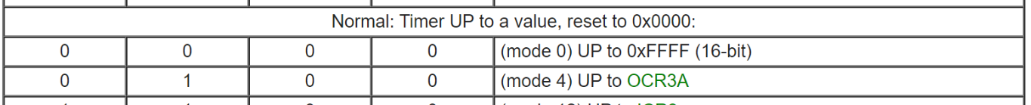
Timers (Example 1)
Draw the graphs of Timer counter + output
+ set pin C6 to 0 at 0xFFFF

Slide 33
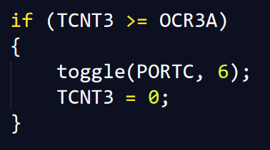
Timers (Example 2)
Draw the graphs of Timer counter + output

Slide 34
PWM with Timers (Answer)
Also see Timers (Example 3) for graphs
There are multiple ways to achieve PWM with Timers, this is one method.
Duty cycle?
OCR3A ÷ 0x00FF

Slide 35
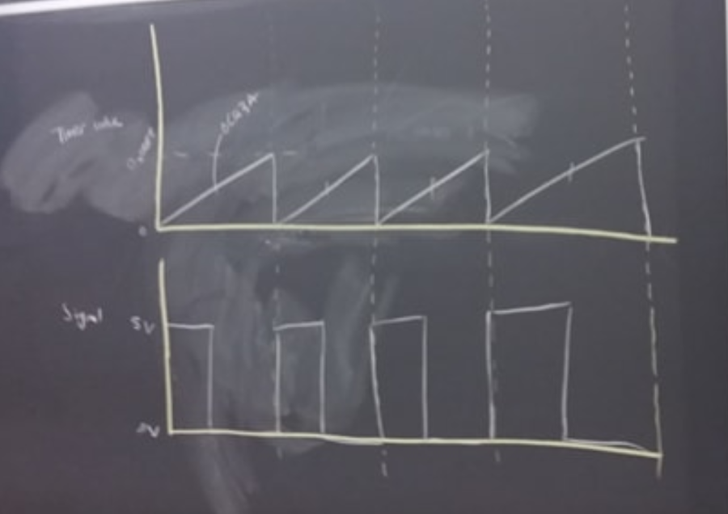
Timers (Example 3: Answer)
OCR3A
Timer counter value
The pin “clears” at OCR3A according to the mode that we’ve set the Timer to (goes to 0V)
The pin “sets” at rollover according to the mode that we’ve set the Timer to (goes to 5V)
Signal at output compare pin OC3A (C6)

Slide 36
Pulse Width Modulation (PWM)
Duty Cycle
Usually expressed in a %
Duty cycle% = on time ÷ period
On time = time that the signal is “high”

Slide 37
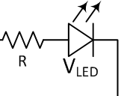
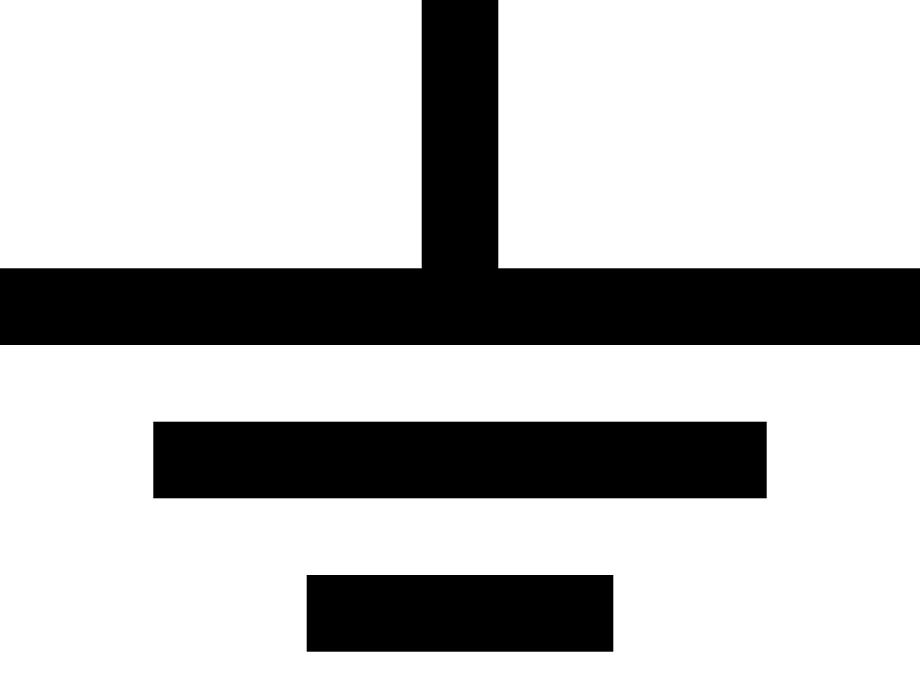
Pulse Width Modulation (PWM)
Dimming an LED:
Blinking an LED too quickly for human eyes to perceive the LED actually turning on or off

Slide 38
Appendix

Slide 39
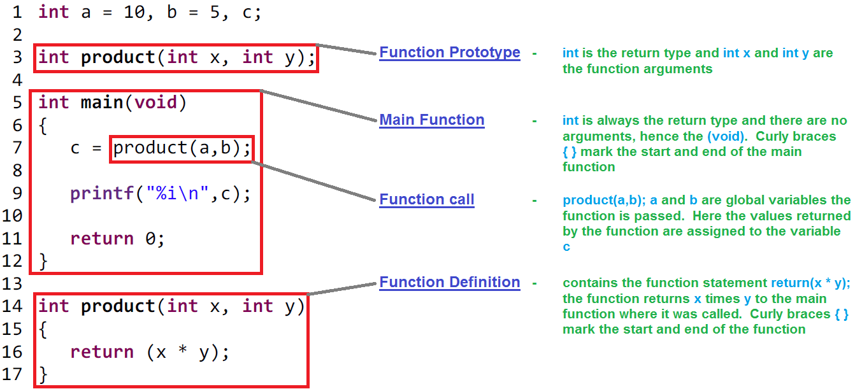
C functions in action: compute the product of two integers
Notes:
A function has four main components
Return type: int
Name: add
Inputs: a, b
Body: return a + b
Side note: you can skip the function prototype altogether and just define the function before the main function for convenience

Slide 40
Macros
Start with the #define flag
Great for defining constants or performing bitwise ops (e.g. set / clear / toggle)
NOT meant to be used to execute series of complicated operations -> functions
How it works : compiler substitutes macro with its definition at compile time
Macro name
Arguments
(optional)
Operations performed on arguments
Notes:
Adjacent to functions, you also have macros in C. Both are meant to make your code modular and making code re-usable.
Where macros help most is defining constants, be it what pin you have your LEDs connected to, or what your PWM duty cycle is. That way, if you want to change those values down the road, it’s a one line change instead of a 10 line change.

